Slide 1
The Basic Practice of Statistics Ninth Edition David S. Moore William I. Notz
Chapter 4
Scatterplots and Correlation
Lecture Slides
© 2021 W. H. Freeman and Company

Slide 2
In Chapter 4, we cover …
Explanatory and response variables
Displaying relationships: Scatterplots
Interpreting scatterplots
Adding categorical variables to scatterplots
Measuring linear association: Correlation
Facts about correlation

Slide 3
Response Variables and Explanatory Variables
A response variable measures an outcome of a study.
An explanatory variable may explain or influence changes in a response variable.

Slide 4
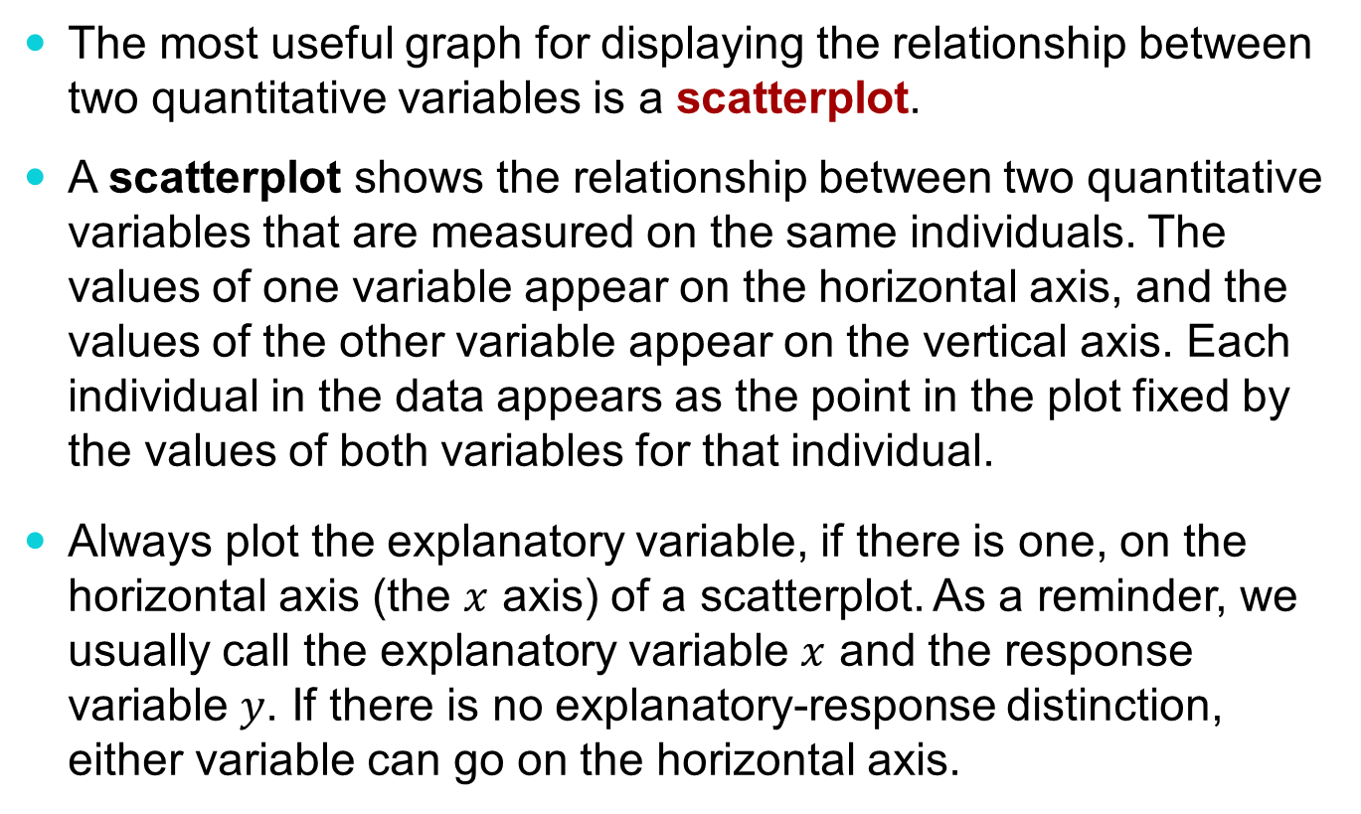
Scatterplot (1 of 3)
The most useful graph for displaying the relationship between two quantitative variables is a scatterplot.
A scatterplot shows the relationship between two quantitative variables that are measured on the same individuals. The values of one variable appear on the horizontal axis, and the values of the other variable appear on the vertical axis. Each individual in the data appears as the point in the plot fixed by the values of both variables for that individual.
Always plot the explanatory variable, if there is one, on the horizontal axis (the $x$ axis) of a scatterplot. As a reminder, we usually call the explanatory variable $x$ and the response variable $y$. If there is no explanatory-response distinction, either variable can go on the horizontal axis.

Slide 5
Scatterplot (2 of 3)
Making the scatterplot in the context of our four-step process:
STATE: The research question of interest is stated as a statement (or a query about a statement) of the association between two variables in your data.
PLAN: The solution of your problem is planned by plotting the variables according to the guidelines on the previous slide.
SOLVE: Examine the scatterplot, taking note of any relationship present.
CONCLUDE: We will explore this step later …

Slide 6
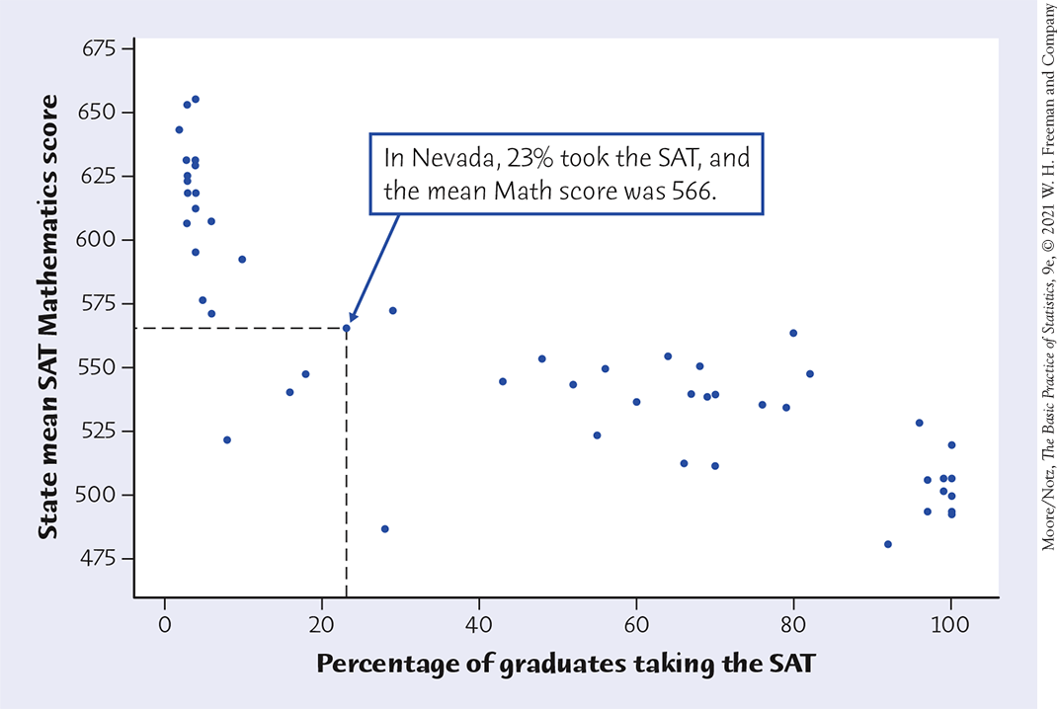
Scatterplot (3 of 3)
Example 4.3: Make a scatterplot of the relationship between the percent taking the SAT and the state’s mean SAT Mathematics score.
% of state’s grads taking SAT | 23 | 55 | 80 | 8 | 18 | 10 | 45 | 100
State mean SAT Math score | 566 | 551 | 538 | 571 | 548 | 592 | 547 | 490

Slide 7
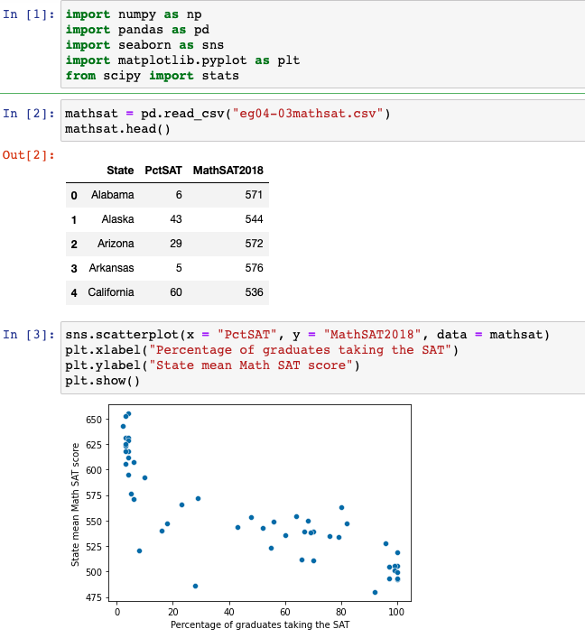
Example 4.3 in Python: Make a scatterplot of the relationship between the percent taking the SAT and the state’s mean SAT Math score.

Slide 8
Interpreting Scatterplots
To interpret a scatterplot, follow the basic strategy of data analysis from Chapters 1 and 2. Look for patterns and important departures from those patterns.
EXAMINING A SCATTERPLOT
In any graph of data, look for the overall pattern and for striking deviations from that pattern.
You can describe the overall pattern of a scatterplot by the direction, form, and strength of the relationship.
An important kind of departure is an outlier—an individual value that falls outside the overall pattern of the relationship.

Slide 9
Direction of Association
POSITIVE ASSOCIATION, NEGATIVE ASSOCIATION
Two variables are positively associated when above-average values of one tend to accompany above-average values of the other, and below-average values also tend to occur together.
Two variables are negatively associated when above-average values of one tend to accompany below-average values of the other, and vice versa.

Slide 10
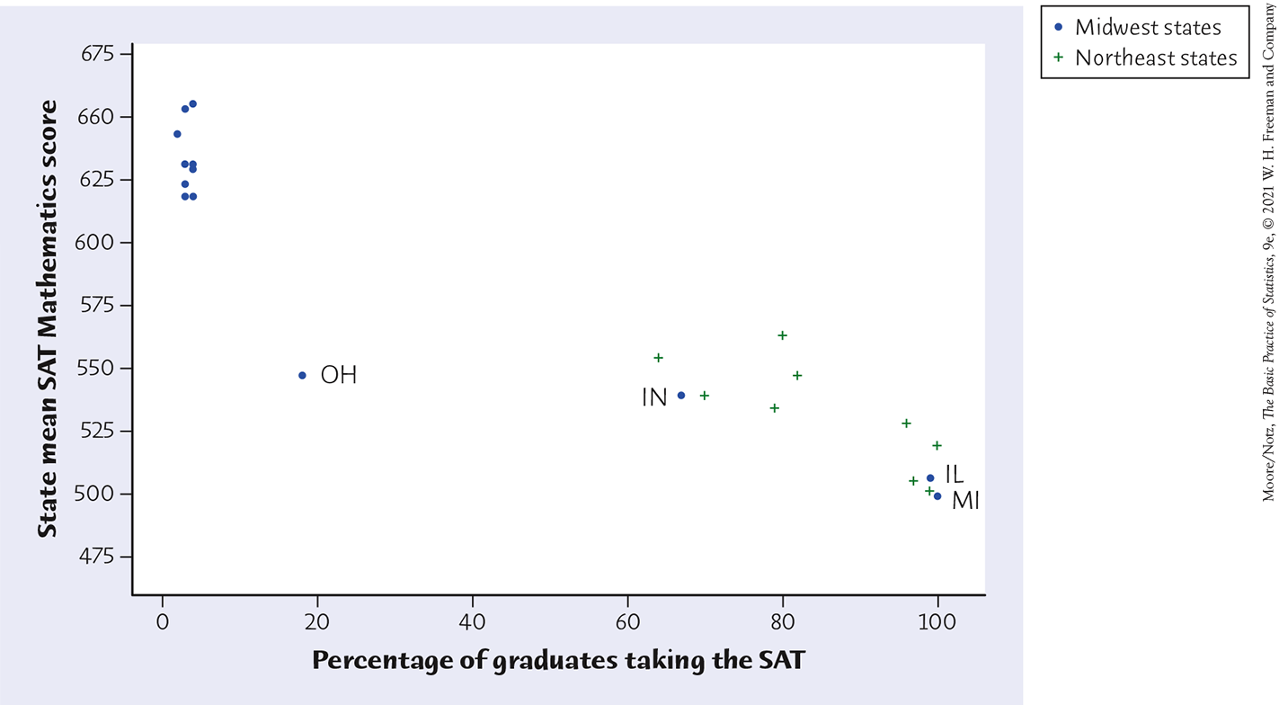
Adding Categorical Variables
Consider the relationship between mean SAT Mathematics score and percent of high-school grads taking the SAT for each state.
Mean SAT Mathematics score and percent of high school graduates who take the test for only the Midwest (•) and Northeast (+) states.

Slide 11
Categorical Variables in Scatterplots
To add a categorical variable, use a different plot color or symbol for each category.

Slide 12
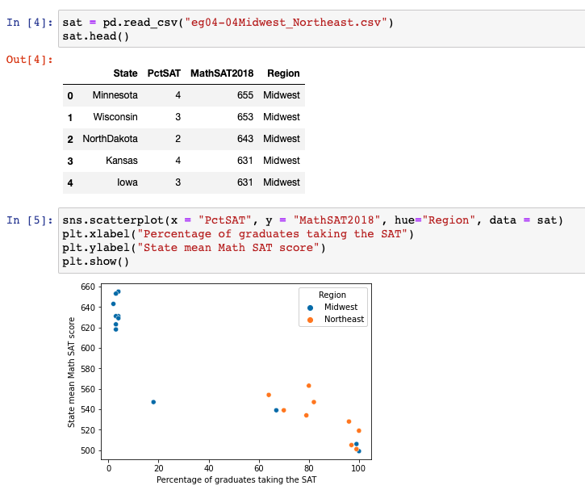
Categorical Variables in Scatterplots
Mean SAT Mathematics score and percent of high school graduates who take the test for only the Midwest (•) and Northeast (•) states.

Slide 13
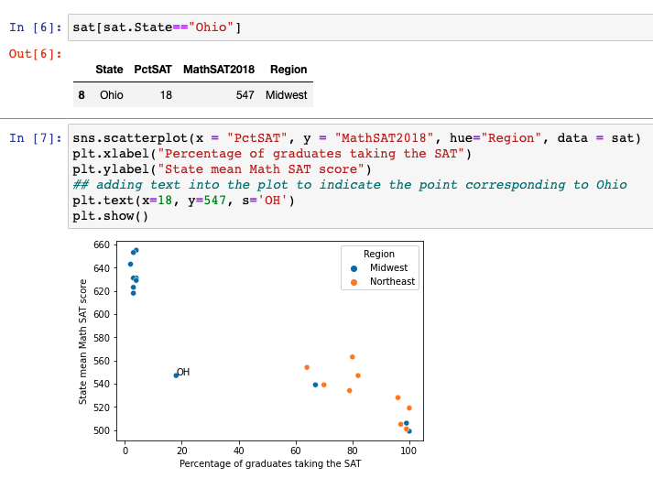
Categorical Variables in Scatterplots
Mean SAT Math score and percent of high school graduates who take the test for only the Midwest (•) and Northeast (•) states.
Adding text to
the plot to indicate OH

Slide 14
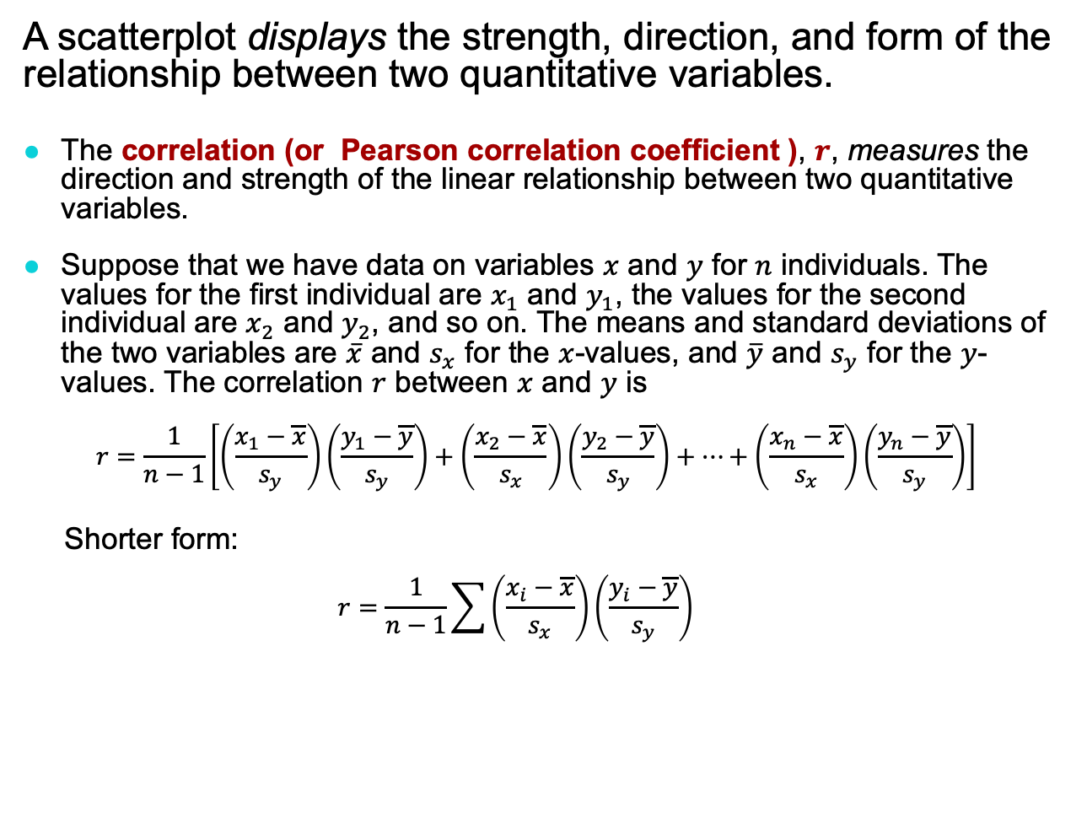
Measuring Linear Association
A scatterplot displays the strength, direction, and form of the relationship between two quantitative variables.
The correlation (or Pearson correlation coefficient ), $r$, measures the direction and strength of the linear relationship between two quantitative variables.
Suppose that we have data on variables $x$ and $y$ for $n$ individuals. The values for the first individual are $x_{1}$ and $y_{1}$, the values for the second individual are $x_{2}$ and $y_{2}$, and so on. The means and standard deviations of the two variables are $\overline{x}$ and $s_{x}$ for the $x$-values, and $\overline{y}$ and $s_{y}$ for the $y$-values. The correlation $r$ between $x$ and $y$ is
$$r=\frac{1}{n−1}\left[\left(\frac{x_{1}−\overline{x}}{s_{y}}\right)\left(\frac{y_{1}−\overline{y}}{s_{y}}\right)+\left(\frac{x_{2}−\overline{x}}{s_{x}}\right)\left(\frac{y_{2}−\overline{y}}{s_{y}}\right)+⋯+\left(\frac{x_{n}−\overline{x}}{s_{x}}\right)\left(\frac{y_{n}−\overline{y}}{s_{y}}\right)\right]$$
Shorter form:
$$r=\frac{1}{n−1}\sum{\left(\frac{x_{i}−\overline{x}}{s_{x}}\right)\left(\frac{y_{i}−\overline{y}}{s_{y}}\right)}$$

Slide 15
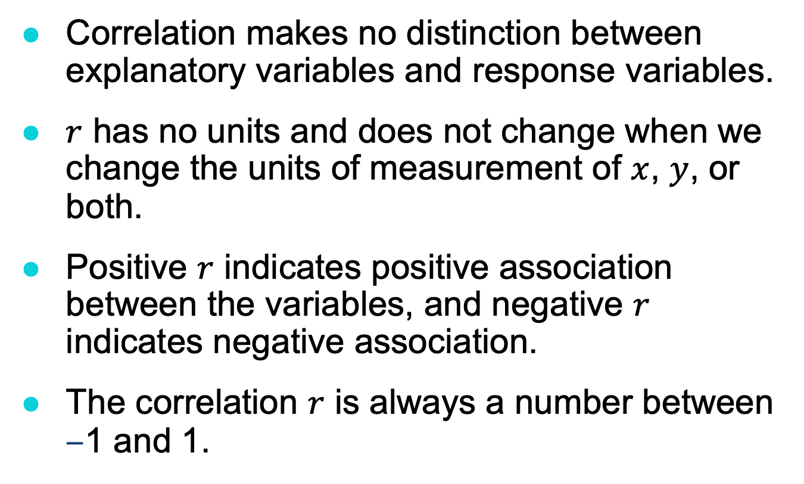
Facts about Correlation (1 of 2)
Correlation makes no distinction between explanatory variables and response variables.
$r$ has no units and does not change when we change the units of measurement of $x$, $y$, or both.
Positive $r$ indicates positive association between the variables, and negative $r$ indicates negative association.
The correlation $r$ is always a number between –1 and 1.

Slide 16
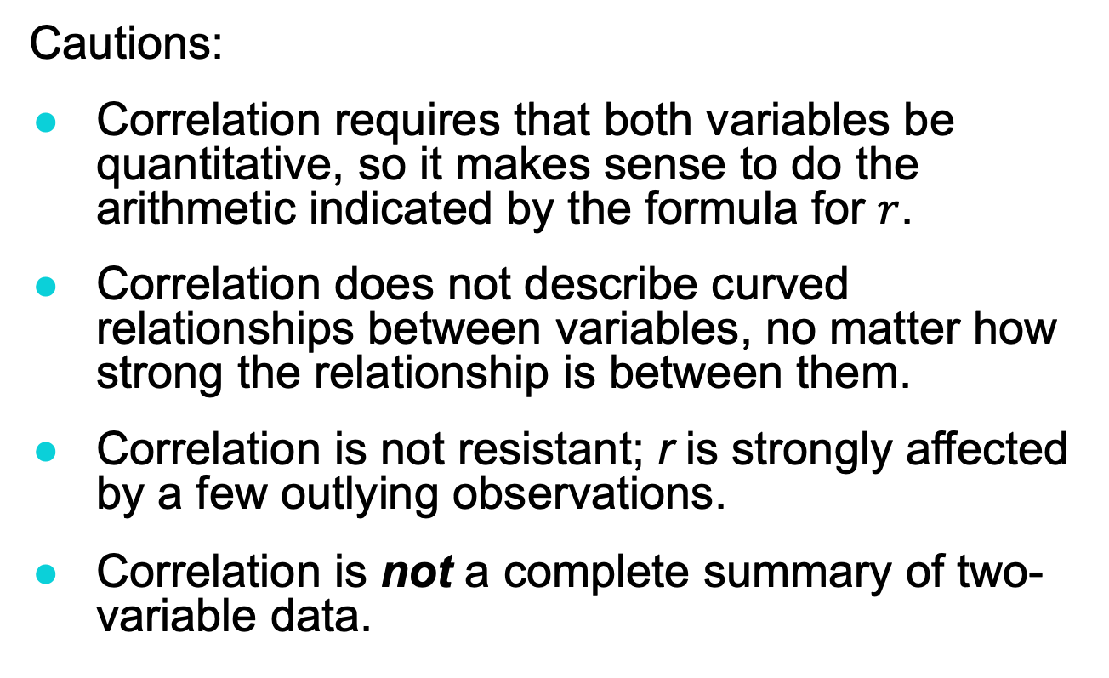
Facts about Correlation (2 of 2)
Cautions:
Correlation requires that both variables be quantitative, so it makes sense to do the arithmetic indicated by the formula for $r$.
Correlation does not describe curved relationships between variables, no matter how strong the relationship is between them.
Correlation is not resistant; r is strongly affected by a few outlying observations.
Correlation is not a complete summary of two-variable data.

Slide 17
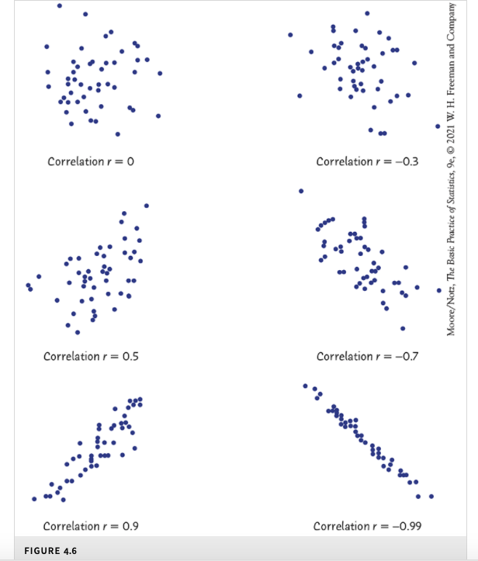
The scatterplots in Figure 4.6
illustrate how values of r closer to 1 or -1 correspond to stronger linear relationships.

Slide 18
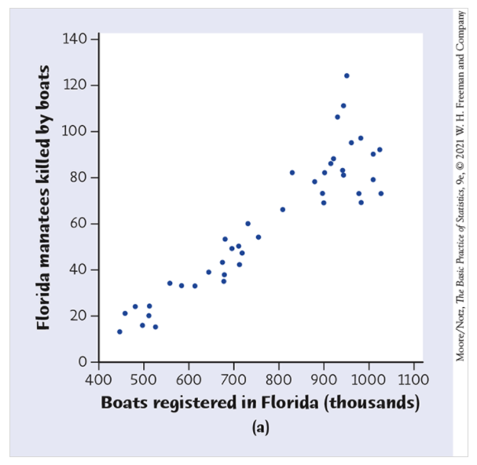
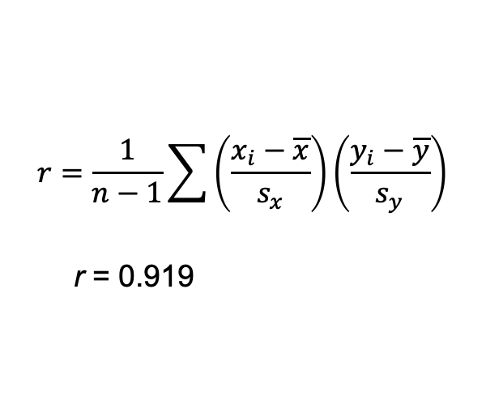
$$r=\frac{1}{n−1}\sum{\left(\frac{x_{i}−\overline{x}}{s_{x}}\right)\left(\frac{y_{i}−\overline{y}}{s_{y}}\right)}$$
r = 0.919
Figure 4.7 (a)

Slide 19
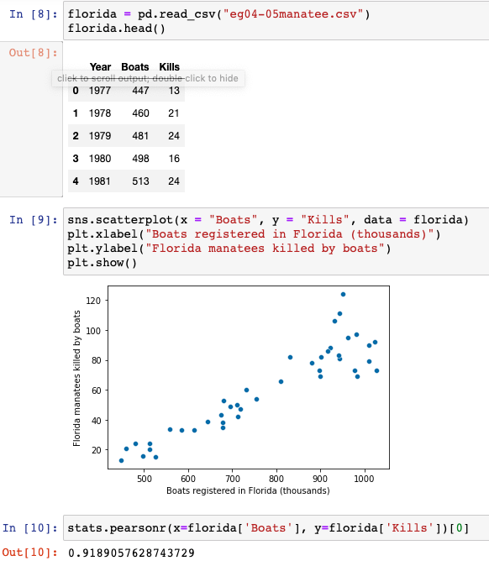
Example from Figure 4.7 (a) in Python
r = 0.919

